Slide 1
Unified Modeling Language
Joshua Murphy
David Proulx
Michaël Petitclerc
CART 353
Professor Rilla Khaled
January 24, 2017

Slide 2
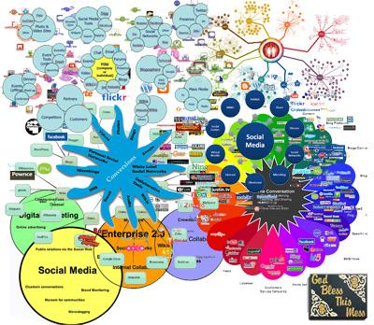
What is the Unified Modeling Language?
Not this →
Notes:
The Unified Modeling Language (UML) is a general-purpose, developmental, modeling language in the field of software engineering, that is intended to provide a standard way to visualize the design of a system.

Slide 3
What is the Unified Modeling Language?
Standardised
Simple
Flexible
Structural
Behavioral

Slide 4
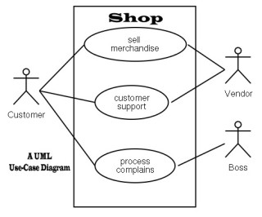
Examples: Use Case

Slide 5
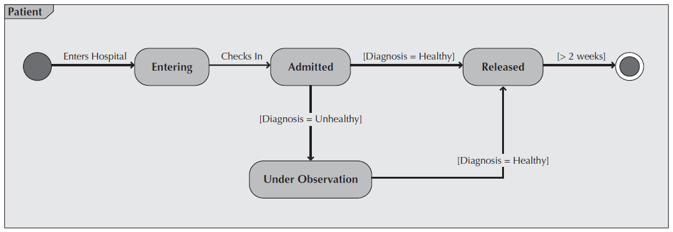
Examples: Behavioral State Machine

Slide 6
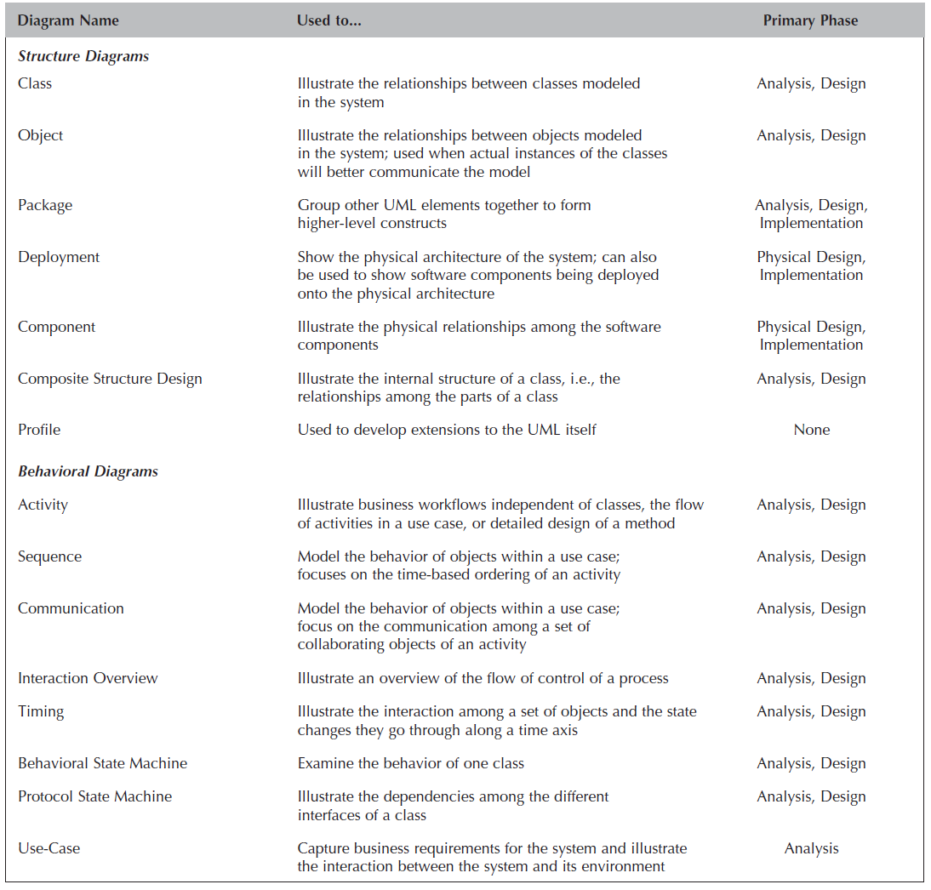
Fifteen useful UML diagrams:

Slide 7
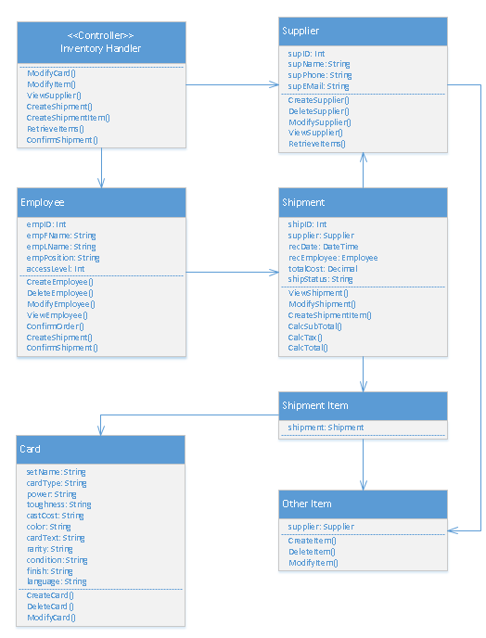
The Class Diagram
A class diagram is a static (structural) diagram that models the classes in a system and the relationships between those classes.
What is it used for?
Planning
Coordination
Documentation

Slide 8
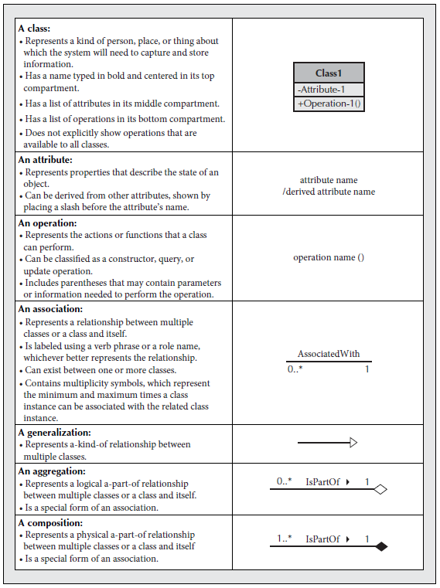
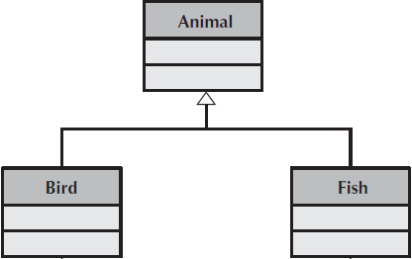
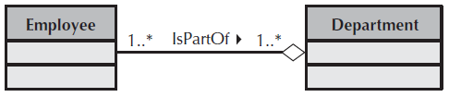
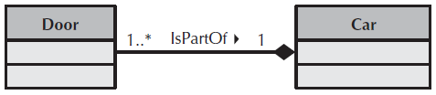

Slide 9
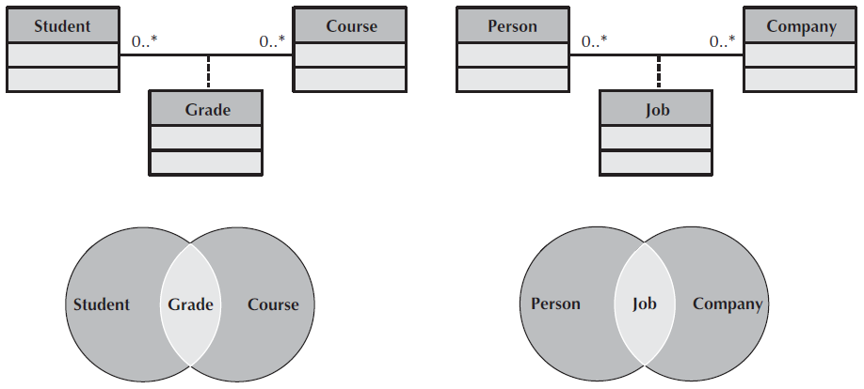
Association Classes
Useful when the relationship itself has associated attributes. This is typical when two classes share a many-to-many relationship.

Slide 10
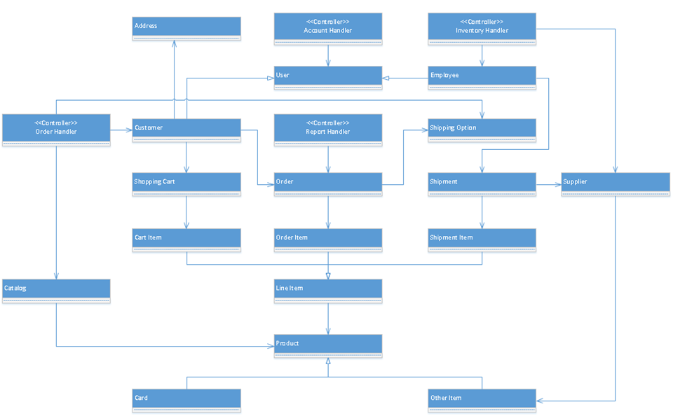

Slide 11
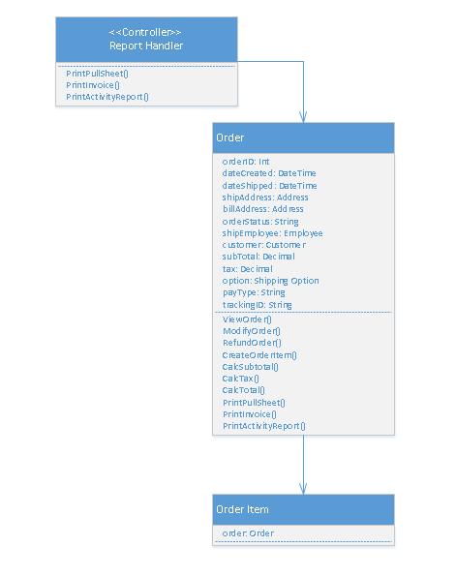

Slide 12
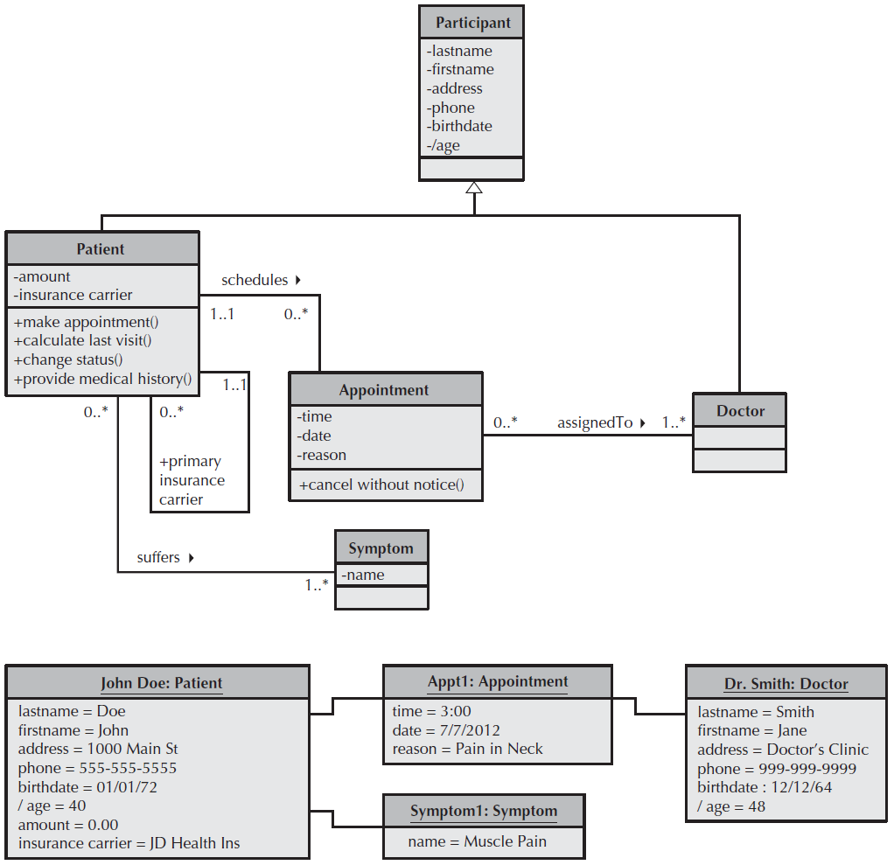

Slide 13
Approaches to Diagramming
Diagrams will often need to be modified repeatedly over the course of a project, even in most cases where extensive planning was done.
The agile approach or the waterfall approach?
Using an iterative approach better accounts for the likelihood of modifications.

Slide 14
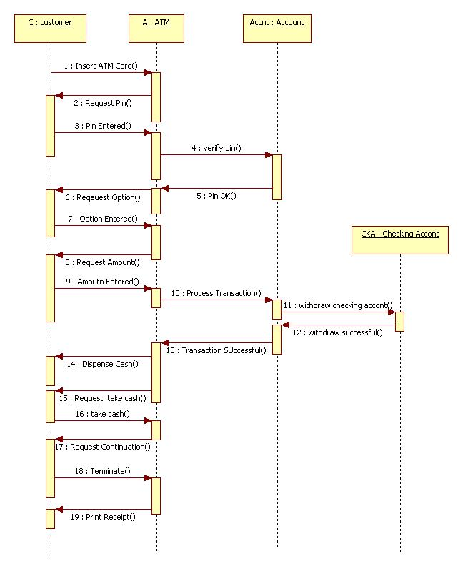
The Sequence Diagram
The sequence diagram illustrates actors and objects, and how they interact in a scenario over time.
Advantages:
Easy to create
Dynamic
Real-time

Slide 15
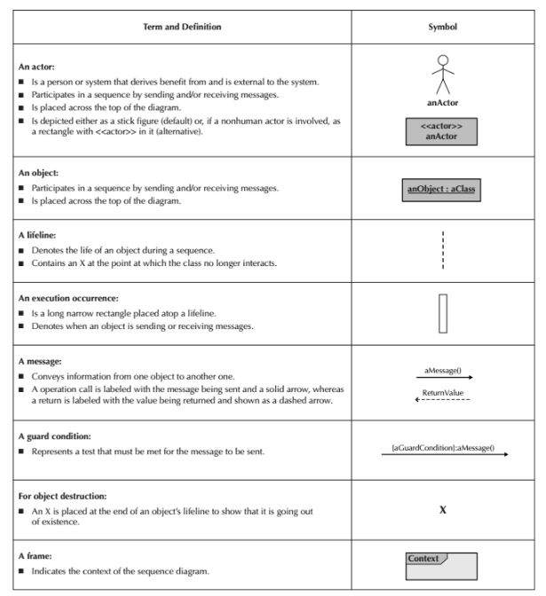
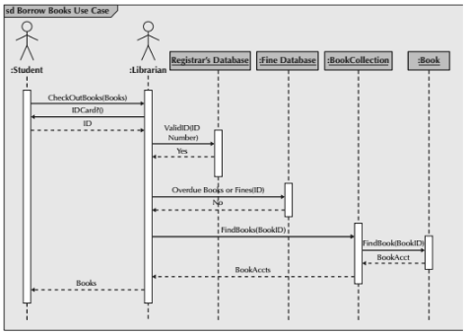

Slide 16
Process of Creation
Establish context
Find actors and objects
Set lifelines
Add messages
Place execution occurrences

Slide 17

Tips for clean design
Keep it simple
Design like you read
Naming convention
Actor/Object duplicates
Object/Object duplicate
Return values

Slide 18
Citations
Dennis, Alan, Barbara Haley Wixom, and David Tegarden. System Analysis & Design: An Object-Oriented Approach with UML. 5th ed. Hoboken, NJ: John Wiley & Sons Inc., 2015.
Harris, James, Jay Maurice, and Joshua Murphy. Face To Face Games Analysis. Unpublished Manuscript, 2015.

